Slide 1
DATABASE MANAGEMENT SYSTEMS
Subject Teacher: Junaid Javed Korai

Slide 2
THE RELATIONAL DATABASE MODEL
Lecture # 5 & 6
Disclaimer: The material used in this presentation to deliver the lecture i.e., definitions/text and pictures/graphs etc. does not solely belong to the author/presenter. The presenter has gathered this lecture material from various sources on web/textbooks. Following sources are especially acknowledged:
Connolly, Thomas M., and Carolyn E. Begg. Database systems: a practical approach to design, implementation, and management. Pearson Education, 2005.
2. Hoffer, Jeffrey A.,Venkataraman Ramesh, and Heikki Topi. Modern database management. Upper Saddle River, NJ: Prentice Hall,, 2011.
2

Slide 3
DATA MODEL
Integrated collection of concepts for describing data, relationships between data, and constraints on the data.
Has three components:
  a structural part;
  a manipulative part;
  a set of integrity rules.

Slide 4
RELATIONAL DBMS
Dr. Edgar F. Codd at IBM invented the relational database in 1970, called Father of RDBMS.
The main elements of RDBMS are based on Codd’s 13 rules for a relational system.
A DBMS is said to be relational if it follows Codd’s rules.

Slide 5
RELATIONAL MODEL TERMINOLOGIES
Tables (Relation) − In relational data model, relations are saved in the format of Tables. This format stores the relation among entities. A table has rows and columns, where rows represents records and columns represent the attributes.
Tuple − A single row of a table, which contains a single record for that relation is called a tuple.
Attribute: The named column of a relation.
Attribute domain − Every attribute has some pre-defined value scope, known as attribute
domain. It is set of allowable values for one or more attributes.
Relational Database - collection of normalized relations with distinct relation names.

Slide 6
RELATIONAL MODEL TERMINOLOGIES
Relation instance − A finite set of tuples in the relational database system represents relation instance. Relation instances do not have duplicate tuples.
Relation schema − A relation schema describes the relation name (table name), attributes, and their names.
Relation key − Each row has one or more attributes, known as relation key, which can identify the row in the relation (table) uniquely.
6

Slide 7
ALTERNATIVE TERMINOLOGY
Relation, attribute, tuple
Table, column, record
File, field, row

Slide 8
PROPERTIES OF RELATIONS
Each record is distinct; there are no duplicate records.
Order of columns has no significance.
Order of records has no significance, theoretically.

Slide 9
PROPERTIES OF RELATIONS
Table name is distinct from all other table names in the database.
Each cell of table contains exactly one atomic (single) value.
Each column has a distinct name.
Values of a column are all from the same domain.

Slide 10
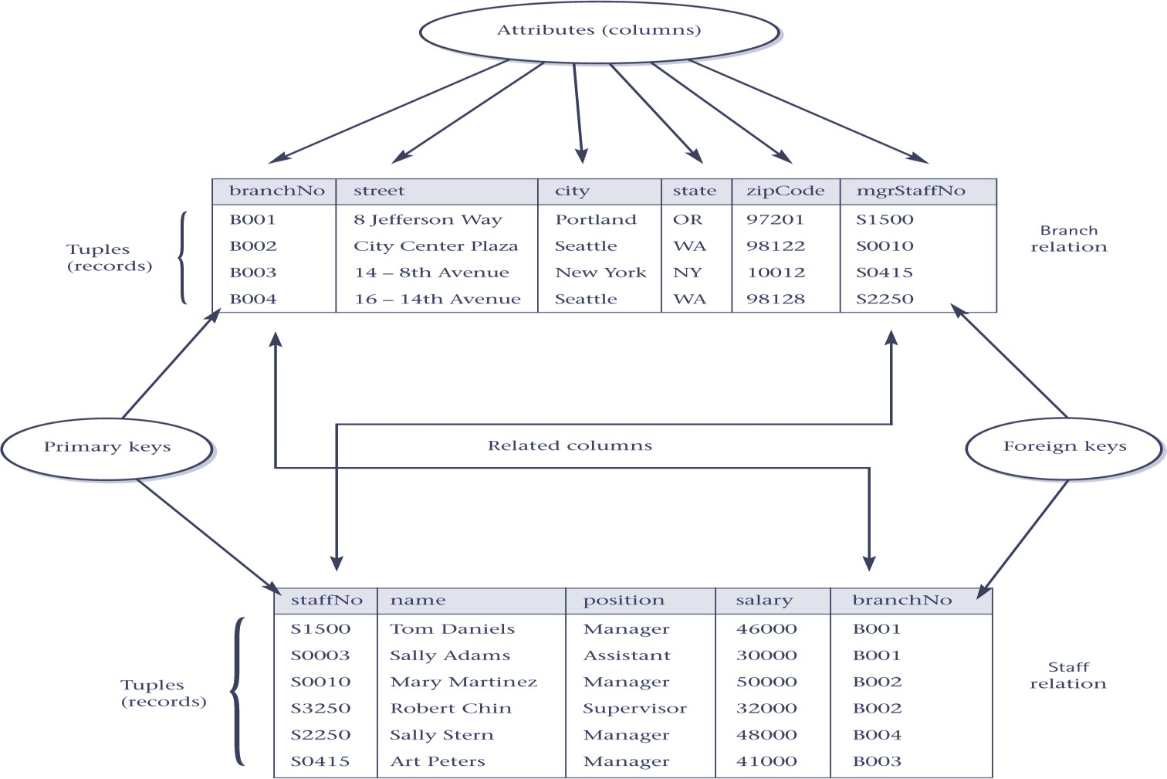
INSTANCES OF BRANCH AND STAFF (PART) RELATIONS

Slide 11
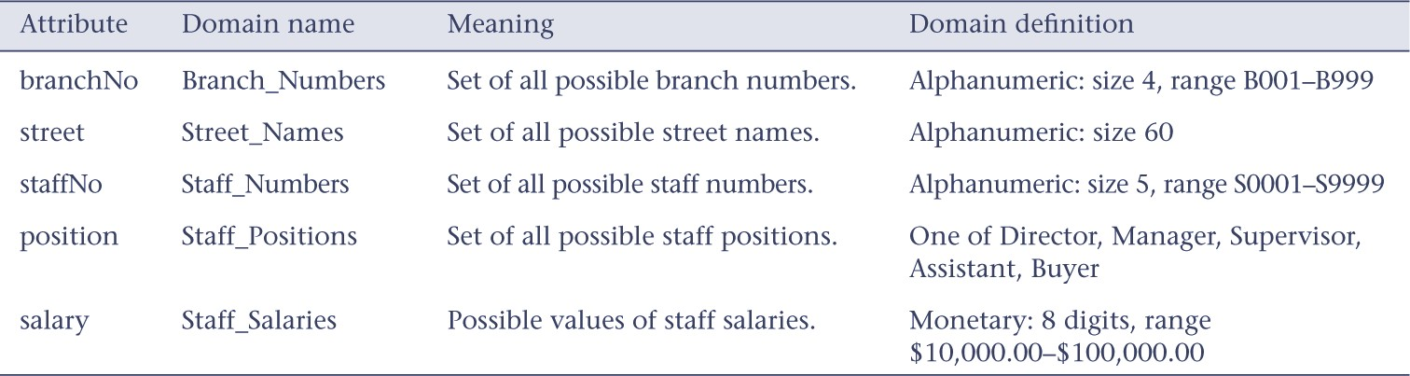
EXAMPLE ATTRIBUTE DOMAINS

Slide 12
RELATIONAL KEYS
Super key
  A column, or a set of columns, that uniquely identifies a record within a table.
  It is further reducible without loosing uniqueness.
  A super key is a set of one or more columns or attributes that can uniquely identify every row in a database table
Candidate Key
  Super key (K) such that no proper subset is a super key within the table.
  In each record, values of K uniquely identify that record (uniqueness).
  No proper subset of K has the uniqueness property (irreducibility).
  A candidate key in a (DBMS) is a single column or a minimal set of columns that can uniquely identify each row in a table.

Slide 13
RELATIONAL KEYS
Primary Key
  Candidate key selected to identify records uniquely within table.
Alternate Keys
  Candidate keys that are not selected to be primary key.
Foreign Key
  Column, or set of columns, within one table that matches candidate key of some (possibly same) table.

Slide 14
RELATIONAL INTEGRITY
Null
  Represents value for a column that is currently unknown or not applicable for record.
  Deals with incomplete or exceptional data.
  Represents the absence of a value and is not the same as zero or spaces, which are values.

Slide 15
RELATIONAL INTEGRITY CONSTRAINTS
Every relation has some conditions that must hold for it to be a valid relation. These conditions are called Relational Integrity Constraints.
There are three main integrity constraints −
  Key constraints (Entity Integrity)
  Referential integrity constraints
  Domain constraints (Business rules)

Slide 16
RELATIONAL INTEGRITY
Entity Integrity
  In a base table, no column of a primary key can be null.
Business Rules
  Rules that define or constrain some aspect of the organization.

Slide 17
























RELATIONAL INTEGRITY
Referential Integrity
If FK exists in a table, either FK value must match a candidate key value of some record in its home table or FK value must be wholly null.
For example: Delete Rules
  Restrict – don’t allow delete of “parent” side if related rows exist in “dependent” side
  Cascade – automatically delete “dependent” side rows that correspond with the “parent”
side row to be deleted
  Set-to-Null – set the foreign key in the dependent side to null if deleting from the parent
side ➔ not allowed for weak entities

Slide 18
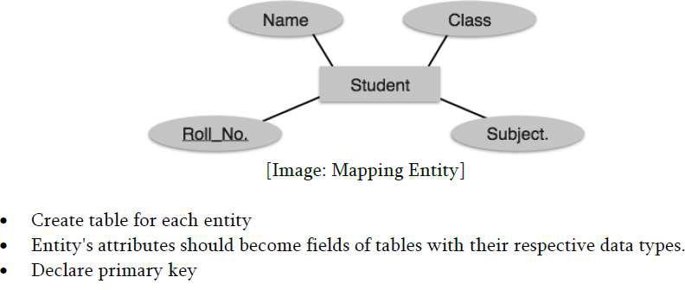
TRANSFORMING ER MODEL TO RELATIONAL MODEL

Slide 19
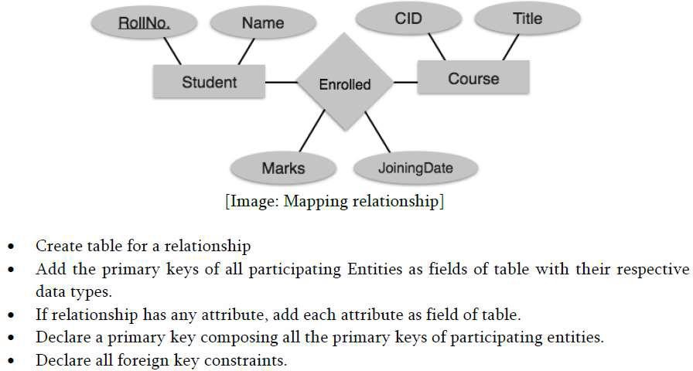
TRANSFORMING ER MODEL TO RELATIONAL MODEL

Slide 20
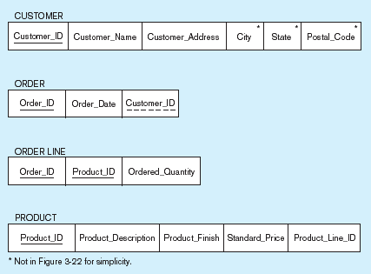
Primary Key
Schema for four relations (Pine Valley Furniture Company)
Foreign Key
(implements 1:N relationship between customer and order)
Combined, these are a composite primary key (uniquely identifies the order line)…individually they are foreign keys (implement M:N relationship between order and product)

Slide 21
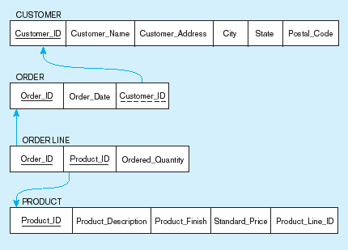
Referential integrity constraints (Pine Valley Furniture)
Referential integrity constraints are drawn via arrows from dependent to parent table

Slide 22
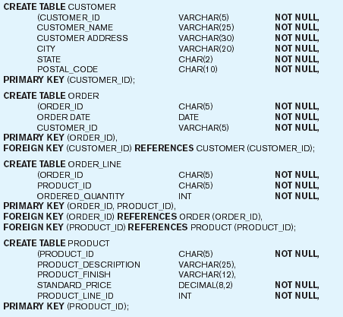
SQL table definitions
Referential integrity constraints are implemented with foreign key to primary key references

Slide 23






TRANSFORMING EER DIAGRAMS INTO RELATIONS
Mapping Regular Entities to Relations
Simple attributes: E-R attributes map directly onto the relation
Composite attributes: Use only their simple, component attributes
Multivalued Attribute–Becomes a separate relation with a foreign key taken from the superior entity
23

Slide 24


Mapping a regular entity
(a) CUSTOMER entity type with simple attributes
(b) CUSTOMER relation

Slide 25


Mapping a composite attribute
(a) CUSTOMER entity type with composite attribute
(b) CUSTOMER relation with address detail

Slide 26

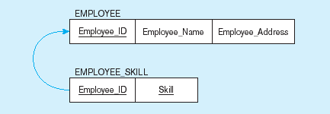
Mapping an entity with a multivalued attribute
(a)
Multivalued attribute becomes a separate relation with foreign key
(b)
One–to–many relationship between original entity and new relation
26

Slide 27







Mapping Weak Entities
TRANSFORMING ER DIAGRAMS INTO RELATIONS (CONT.)
Becomes a separate relation with a foreign key taken from the superior entity
Primary key composed of:
  Partial identifier of weak entity
  Primary key of identifying relation (strong entity)
27

Slide 28
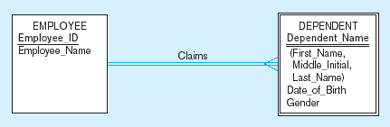
Example of mapping a weak entity
a) Weak entity DEPENDENT

Slide 29
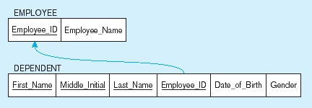
Example of mapping a weak entity (cont.)
b) Relations resulting from weak entity
NOTE: the domain constraint for the foreign key should NOT allow null value if DEPENDENT is a weak entity
Foreign key
Composite primary key

Slide 30









TRANSFORMING ER DIAGRAMS INTO RELATIONS (CONT.)
Mapping Binary Relationships
One-to-Many–Primary key on the one side becomes a foreign key on the many side
Many-to-Many–Create a new relation with the primary keys of the two entities as its primary key
One-to-One–Primary key on the mandatory side becomes a foreign key on the optional side
30

Slide 31
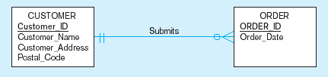
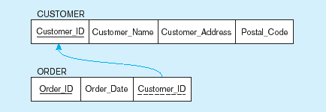
Example of mapping a 1:M relationship
a) Relationship between customers and orders
Note the mandatory one
b) Mapping the relationship
Again, no null value in the foreign key…this is because of the mandatory minimum cardinality
Foreign key

Slide 32
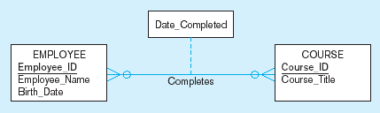
Example of mapping an M:N relationship
a) Completes relationship (M:N)
The Completes relationship will need to become a separate relation

Slide 33
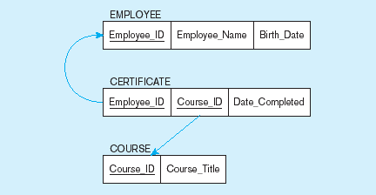
Example of mapping an M:N relationship (cont.)
b) Three resulting relations
Composite primary key
Foreign key
New intersection relation
Foreign key

Slide 34
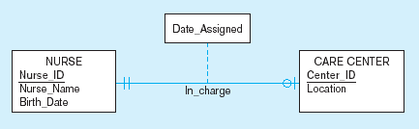
Example of mapping a binary 1:1 relationship
a) In_charge relationship (1:1)
Often in 1:1 relationships, one direction is optional.

Slide 35
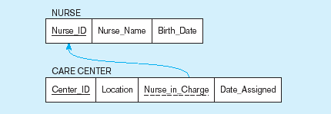
Example of mapping a binary 1:1 relationship (cont.)
b) Resulting relations
Foreign key goes in the relation on the optional side, Matching the primary key on the mandatory side

Slide 36









Mapping Associative Entities
TRANSFORMING EER DIAGRAMS INTO RELATIONS (CONT.)
Identifier Not Assigned
  Default primary key for the association relation is composed of the primary keys of the two entities (as in M:N relationship)
Identifier Assigned
  It is natural and familiar to end-users
  Default identifier may not be unique
36

Slide 37
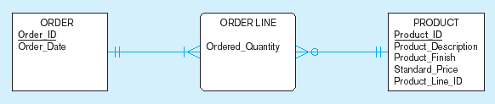
Example of mapping an associative entity
a) An associative entity

Slide 38
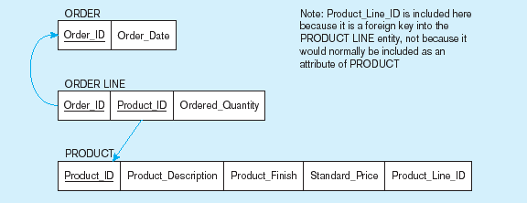
Example of mapping an associative entity (cont.)
b) Three resulting relations
Composite primary key formed from the two foreign keys

Slide 39

a) SHIPMENT associative entity
Example of mapping an associative entity with an identifier

Slide 40
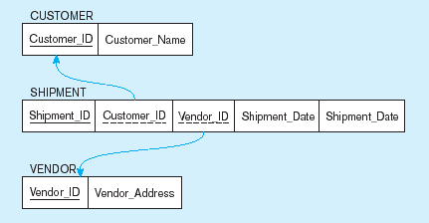
Example of mapping an associative entity with an identifier (cont.)
b) Three resulting relations
Primary key differs from foreign keys

Slide 41



Mapping Unary Relationships
TRANSFORMING EER DIAGRAMS INTO RELATIONS (CONT.)
One-to-Many–Recursive foreign key in the same relation
Many-to-Many–Two relations:
  One for the entity type
  One for an associative relation in which the primary key has two attributes, both taken from the primary key of the entity
41

Slide 42
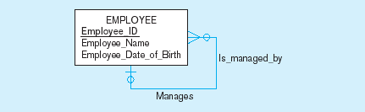

Mapping a unary 1:N relationship
(a) EMPLOYEE entity with unary relationship
(b) EMPLOYEE relation with recursive foreign key

Slide 43
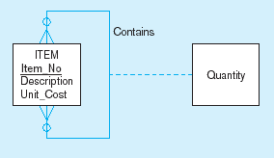
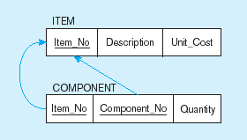
Mapping a unary M:N relationship
(a) Bill-of-materials relationships (M:N)
(b) ITEM and COMPONENT relations

Slide 44







Mapping Ternary (and n-ary) Relationships
TRANSFORMING EER DIAGRAMS INTO RELATIONS (CONT.)
One relation for each entity and one for the associative entity
Associative entity has foreign keys to each entity in the relationship
44

Slide 45
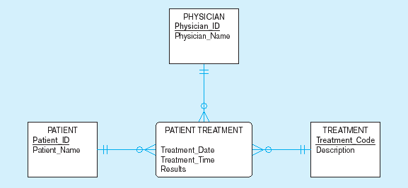
Mapping a ternary relationship
a) PATIENT TREATMENT Ternary relationship with associative entity
45

Slide 46
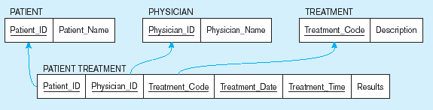
Figure 5-19 Mapping a ternary relationship (cont.)
b) Mapping the ternary relationship PATIENT TREATMENT
Remember that the primary key MUST be unique
This is why treatment date and time are included in the composite primary key
But this makes a very awkward key…
It would be better to create a surrogate key like Treatment#
46

Slide 47





TRANSFORMING EER DIAGRAMS INTO RELATIONS (CONT.)
Mapping Supertype/Subtype Relationships
One relation for supertype and for each subtype
Supertype attributes (including identifier and subtype discriminator) go into supertype relation
Subtype attributes go into each subtype; primary key of supertype relation also becomes primary key of subtype relation
1:1 relationship established between supertype and each subtype, with supertype as primary table
47

Slide 48
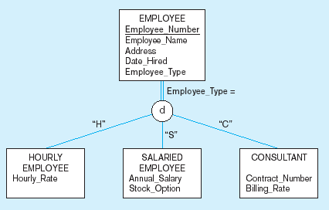
Supertype/subtype relationships

Slide 49
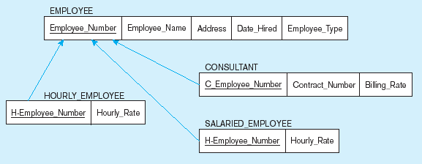
Mapping Supertype/subtype relationships to relations
These are implemented as one-to-one relationships

Slide 50
RELATIONAL LANGUAGES
Two main languages:
  SQL (Structured Query Language), standardized by ISO.
  QBE (Query-by-Example), alternative graphical “point-and-click” way of querying database.

